Slide 1
AI IN SUPPLY CHAIN MANAGEMENT
in the automotive industries

Slide 2
INTRODUCTION
In the Indian context, Ganeshan et al. (1995) have defined supply chain as “A supply chain is a network of facilities and distribution options that performs the functions of procurement of materials, transformation of these materials into intermediate and finished products, and the distribution of these finished products to customers”
After going through different definitions and statements on supply chain by various authors, it is fairly understandable to comprehend that supply chain management is the management of materials and information both in and between various facilities, such as suppliers, customers, manufacturing and assembly locations and distribution points.

Slide 3
Supply Chain in Automotive Industry
Supply chain is defined as integrated net structure where the core enterprises control the flows of information, materials, and capital from the supplier, manufacturer, distributor, and retailer.
The automobile industry forms supply-manufacture-sale-service supply chain structure by means of new production research and development, design, raw materials supply, components processing, assemble, distribution and after-sales service. In this chain, the added value of each link has a great difference

Slide 4
NEED OF SCM IN AUTOMOBILE INDUSTRY
SCM supports in product ordering, replenishment, inventory control and more importantly, better control over logistic management, merchandising and marketing operations. SCM also facilitates demand forecasting, customer data analysis, customer relation management which can be effectively used in replenishment of product, production scheduling, order processing, order delivery, etc., which will further help in smooth functioning of automobile companies. So, the study of supply chain management in automobile industry is the need of the hour

Slide 5
SUPPLY CHAIN CHALLENGES
With the automotive industry continually evolving, logistics can be complex. Automotive companies need to rethink their supply chain strategies in order to exploit new market opportunities, reduce costs and maintain competitive advantage.

Slide 6
SUPPLY CHAIN CHALLENGES
Efficiency An assembly plant can cost up to half a billion euros, which puts immense pressure on the manufacturer to get the absolute maximum from its investment. For optimal utilization, the raw materials and components must be available to the plant in close co-ordination with the production schedule. The development of ‘build-to-order’ or ‘just in time’ systems also demand a more flexible production environment and more responsive supply chains.
Emerging markets and globalization China’s ascendency to become the largest market – and Russia’s growing eminence in Europe – is presenting challenges through inadequate transport infrastructures and economic uncertainty. Building new assembly plants in these regions and integrating them into the global production network is necessary. Providing the right kind of logistical support will be vital. As components more often come from further away, managing their journey to the plant is critical. Cross-border transport and customs clearance add another layer of complexity to be addressed.

Slide 7
SUPPLY CHAIN CHALLENGES
Collaboration One increasingly popular way to lower costs and minimize risk is through collaboration. Many of the industry’s biggest names form alliances to work together, particularly across supply chains, procurement and development.
Talent Finding the right people is key to a successful supply chain. Skilled engineers often move to align with industry demands. Finding talent can get difficult in some areas. Managing an evolving supply chain will demand employees of the highest quality with the appropriate technical knowledge and experience.
Sustainability Companies want to reduce carbon emissions across the manufacturing lifecycle, not just in the finished product. Together with their providers, they develop embedded sustainability programs and reduce the carbon footprint in day to day operations across the entire supply chain.

Slide 8
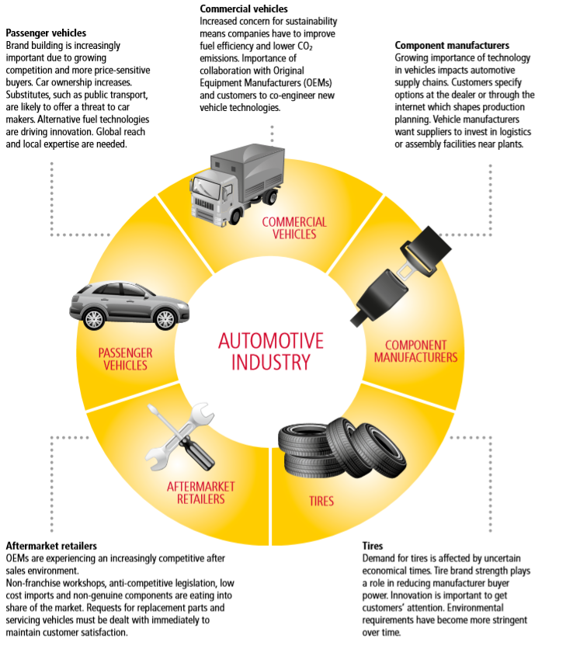
AUTOMOTIVE SUB-SECTORS AND THEIR SUPPLY CHAIN DYNAMIC

Slide 9
Machine Learning Use cases in Automotive Sector
1. Quality Control Image recognition and anomaly detection are types of machine learning algorithms that can quickly detect and eliminate faulty parts before they get into the vehicle manufacturing workflow. Predictive analytics can be used to evaluate whether a flawed part can be reworked or needs to be scrapped.
2. Root Cause Analysis When an issue arises at any point in the product lifecycle — whether it’s something found early in the manufacturing process or an issue affecting multiple vehicles in the field — organizations scramble to determine the exact cause and how to resolve it. The brand’s reputation (and possibly consumer safety) are at stake.

Slide 10
Machine Learning Use cases in Automotive Sector
3. Predictive Maintenance Predictive maintenance helps increase customer satisfaction and brand reputation, while also improving compliance with recommended maintenance. It can also be a source of additional revenue for car makers as an added-value service.
4. Supply Chain Optimization Throughout the supply chain, analytical models are used to identify demand levels for different marketing strategies, sale prices, locations and many other data points. Ultimately, this predictive analysis dictates the inventory levels needed at different facilities. holding costs. Machine learning is helping parts and vehicle manufacturers — and their logistics partners — be more efficient and profitable, while enhancing customer service and brand reputation.

